Slide 1
Erasmus Digital Solutions
Gürol Berkay Çınar, Irem Nur, Oskar Vonkavaara, Tilda Wallin, Nadiia Yeromina

Slide 2





EDS team
Erasmus Digital Solutions is a consulting agency that was hired by the Braga Police Department to help organize and store data about cases.
Gürol Berkay Çınar Irem Nur Oskar Vonkavaara Tilda Wallin Nadiia Yeromina

Slide 3
Table of contents
Logical modelling
1
Definition of the system
4
2
Requirements gathering and analysis
5
Conclusion and future work
3
Conceptual modelling

Slide 4
Definition and characterization
Erasmus Digital Solutions is a digital consultant company with highly skilled labor force
As of late, the city of Braga has struggled with increased criminality; 440 burglaries and 120 robberies 2023. Increase of 8.5% from previous year.
Braga Police Station stores their data manually, creating extra work for employees
As criminality has increased, the demand for a digitized data storage also increased.

Slide 5
Definition and characterization
After consulting with Braga Police Station, the needs and goals of the database system was defined together with EDS. Among these were:
Improve the ability to collect and store information about crimes.
Coordinate the gathered material in a way that makes the navigation process in old data more accessible.
Allow for analysis of data collected in past cases.
Create a search path for specific cases, and filter search results based on different criterias such as; dates, locations, crime types, staff involved etc.
Have a specific structure of access to information among the colleagues at the police station, all members of the database should not access all data.
Since EDS have years of expertise in the field, they thought it would be perfectly possible to carry out the work.

Slide 6
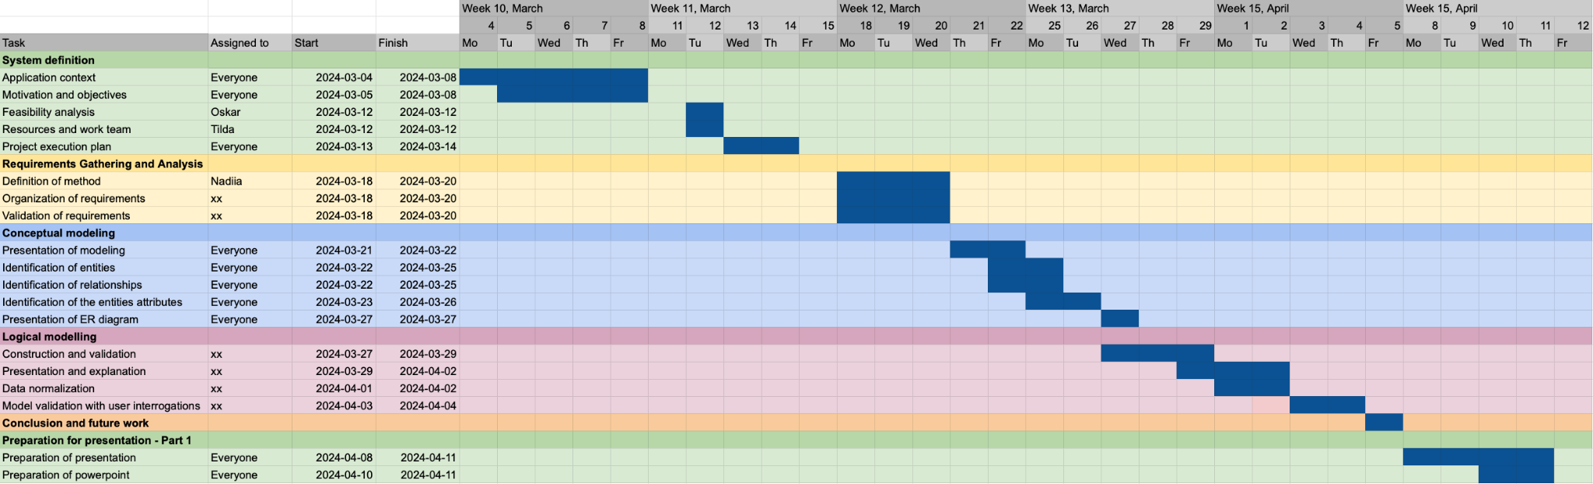
Definition and characterization
The project was planned to be presented to the Chief police officers at the 12th of April.

Slide 7
2. Requirements gathering
Meetings with station employees
Observation
Motive: Form technical task
Motive: Overview activities and workflow at the station
Surveys
Analysis of documentation
Motive: Understanding client needs
Motive: Overview the documentation that’s about the be included in the digital system

Slide 8
2. Requirements
“Each case should have its unique ID which is chosen by some specifics of the case “
“Each case is defined by their lead officer, date of occurrence, location, type of crime and victim”
“Suspects are associated with at least one case”

Slide 9
3. Conceptual modeling
Gather Details: We collect and characterise data about the system's building blocks (entities), their properties (attributes), and how they connect (relationships).
Develop: In our case, we chose to develop a conceptual scheme for each of the usage views, we identified (Employee,Department, Report, Case, Suspect)
Visualize the System: This data is transformed into a clear blueprint using an ERD, showing entities, their details, and the connections between them.
STEP 1: Identification and Characterization of Entities
STEP 2: Identification and Characterization of Relationships
STEP 3: Identification and Characterization of the Attributes of Entities and Relationships.

Slide 10
3. Conceptual modeling
The core entities are:
Case: Represents a crime or incident being investigated.
Employee: Represents a police officer working at the station.
Department: Represents a specific division within the police station
Suspect: Represents an individual suspected of involvement in a case.
Report: Represents a formal record of a crime or incident reported to the station.
Important relationships:
Employee (works_at) Department (One-to-Many)
Employee (investigates) Case (Many-to-Many)
Employee (reported_to) Report (One-to-Many)
Case (committed_by) Suspect (Many-to-Many)
Report (case_opened) (One-to-One)

Slide 11
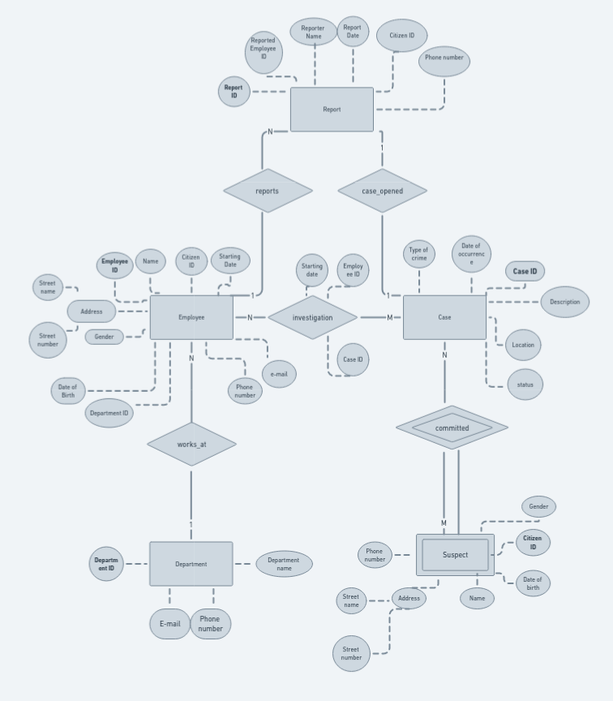

Slide 12
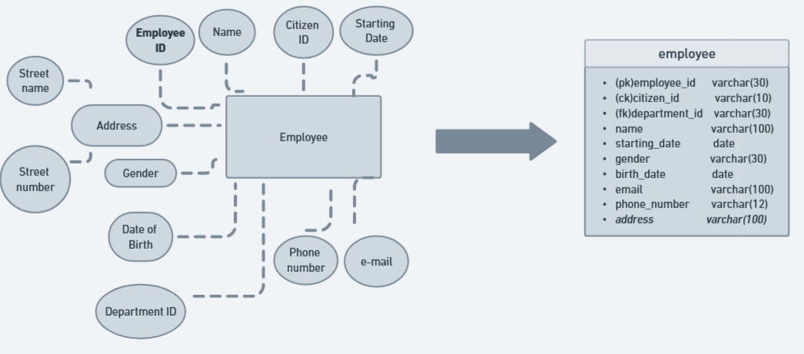
4. Logical modeling
To further bridge the gap between the conceptual design and the implementation, a logical model that is based on the previously shown conceptual model was created.

Slide 13
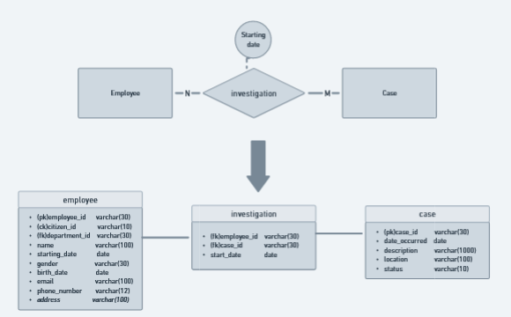
4. Logical modeling
In addition to the previously defined entities, some relations required additional tables to be implemented.
N - M relations require additional tables to be properly represented.
Since the relation “investigation” has an attribute that is not associated with neither of it’s entities it should be included in a seperate table.

Slide 14
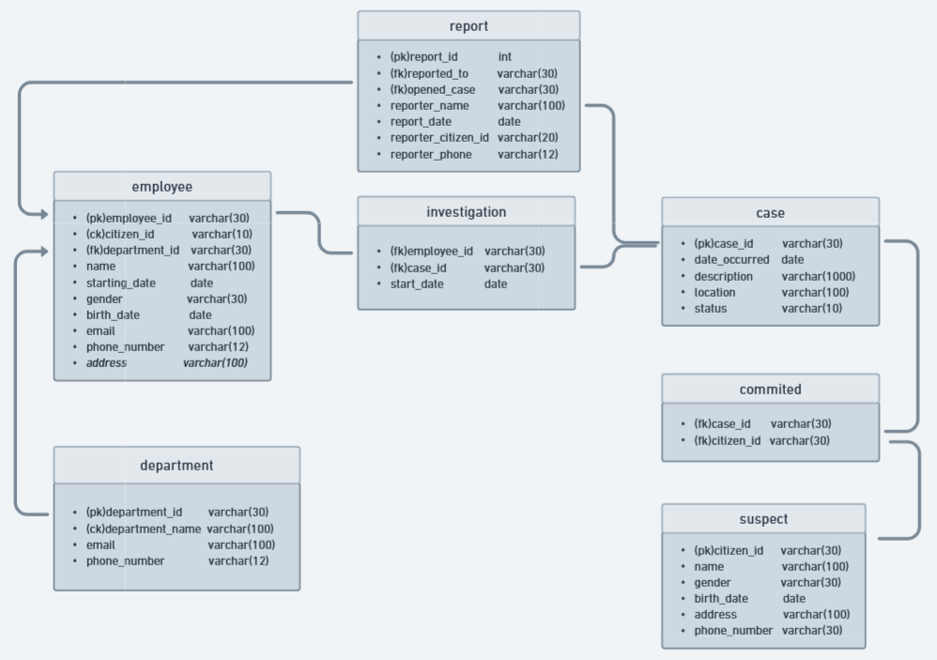

Slide 15
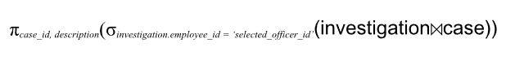
4. Logical modeling
To validate that our model satisfies the requirements agreed beforehand relational algebra statements were used.
It must be possible to view all the cases a police officer has worked on.
It must be possible to view all officers of a specified department.

Slide 16
5. Conclusion and future
To briefly summarize the work done, 4 steps have been completed so far.
The first stage was to identify the problem, fully understand the request of the Braga Polis Station and decide what to do about it.
The aim of the second stage was to determine our requirements when establishing our system, understand their reasons and categorize our requirements. We continued by preparing a table about this.
At the third stage we created a conceptual model with using an ER diagram before moving on to the logical modeling. With this conceptual map, we showed our entities, their attributes and strong and weak relationships between them.
Finally at the last step, we produced our logical modeling. We developed a model based on standardization by following the rules of normalization.

Slide 17
5. Conclusion and future
With these steps and work we have completed, we have not only learned how the model development stages work, but also improved our theoretical knowledge. Although we had some difficulties in terms of language problems and finding sufficient resources while making the design, we have reached the point we wanted with our work.
Our future work based on the theoretical part we have prepared is to make this work physical and create database. For this development, we will start by learning how to code in SQL and obtaining information about this software.

Slide 18
Thanks for Listening!
Questions?

